Slide 1
Generative Adversarial Network
Lu Yunlong October 26, 2018

Slide 2
Outline
Generative vs Discriminative algorithms
How GAN works
Conditional GAN
Structure for translation invariance: DCGAN
Implementation in Tensorflow
Problems of GAN
WGAN: huge improvement
Applications of GAN
Current state-of-the-art

Slide 3
Generative vs Discriminative algorithms
data: x label: y
Discriminative algorithms:
Try to classify input data
predict p(y|x)
Generative algorithms:
Care about “how to get data x of label y”
predict p(x|y)

Slide 4
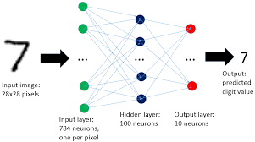
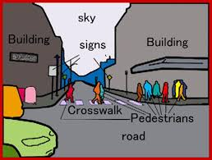
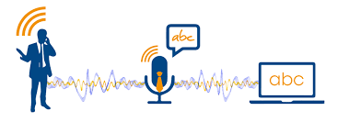
Discriminative algorithms
Recognize handwritten digits
Classify scenes and objects
Understanding human words

Slide 5
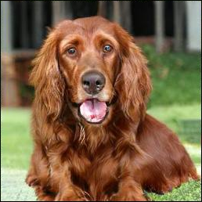
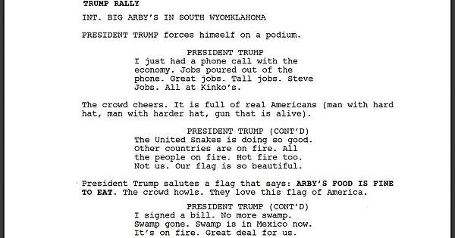
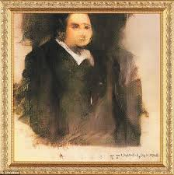
Generative algorithms
Generate new images
Create paintings with specific style
Generate human speech

Slide 6
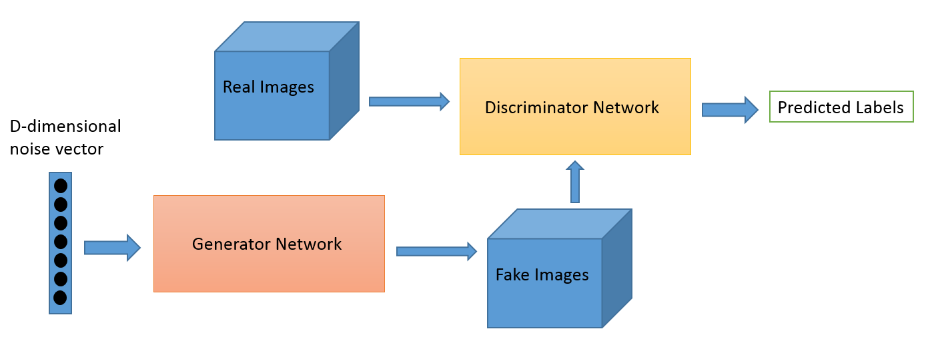
How GAN works
A discriminator try to distinguish fake images from real ones.
A generator try to fool discriminator with generated images.

Slide 7

GAN on MNIST

Slide 8
Loss function
Symbol | Meaning
pz | Data distribution over noise input z
pg | The generator’s distribution over data x
pr | Data distribution over real sample x
For discriminator D, we want to make sure its decisions over real data are accurate by maximizing Ex~pr(x)[logD(x)].
Meanwhile, given a fake sample G(z), z~pz(z), it’s expected to output a probability, D(G(z)), close to 0 by maximizing Ez~pz(z)[log(1-D(G(z)))]
For generator G, it’s trained to increase the chances of D producing a high probability for a fake example, thus to minimize Ez~pz(z)[log(1-D(G(z)))]

Slide 9
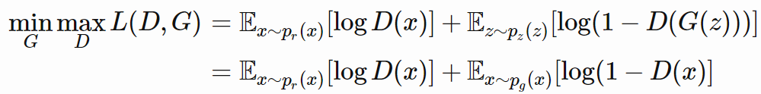
Loss function
D and G are playing a minimax game in which we should optimize the following loss function:

Slide 10
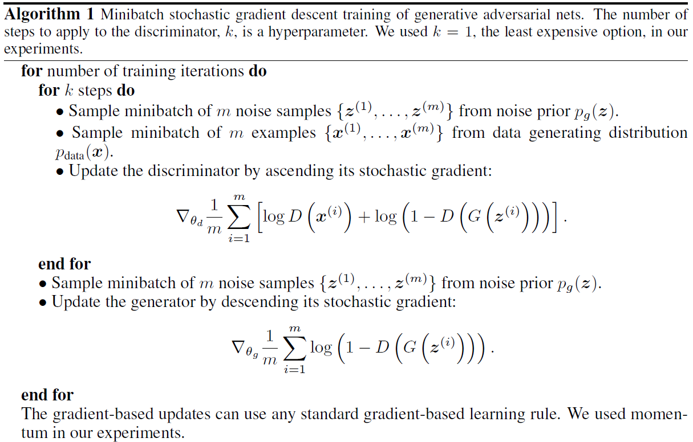
GAN algorithm

Slide 11
Ideal case
At first discriminator gradually learns to discriminate between real images and fake images.
Meanwhile the generator learns to generate high quality images to fool the discriminator.
At last the generator can create images the discriminator cannot tell from real ones, and the discriminator can only output 0.5.

Slide 12
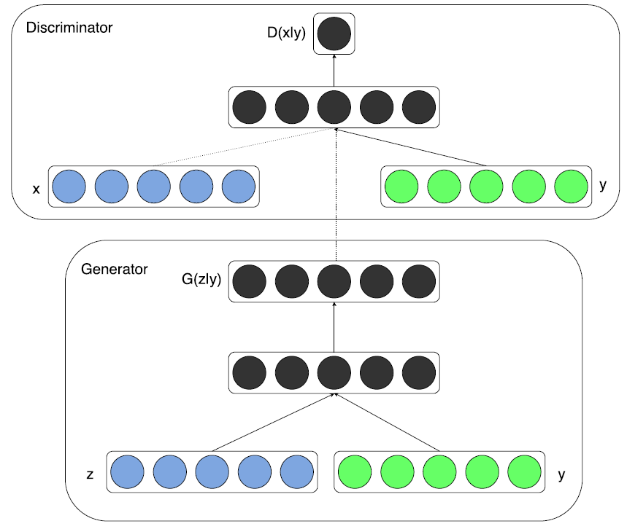
Conditional GAN
How to get x of label y when you have multiple labels?

Slide 13
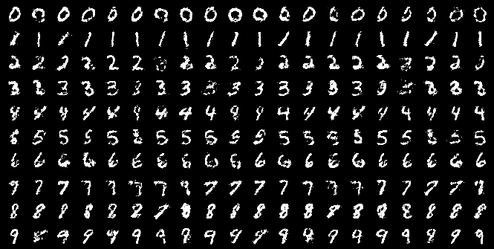
Conditional GAN
Loss function becomes

Slide 14
Combined with Conv Net
“UNSUPERVISED REPRESENTATION LEARNING WITH DEEP CONVOLUTIONAL GENERATIVE ADVERSARIAL NETWORKS” 2015
Both the generator and discriminator use convolutional network.
Use batch normalization.
No fully connected hidden layers.
Use ReLU in generator for all layers except for the output, which uses Tanh.
Use LeakyReLU in discriminator for all layers.

Slide 15
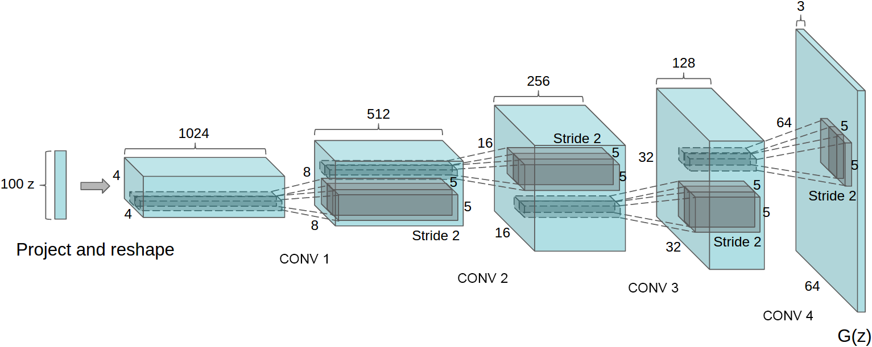
Combined with Conv Net
Generator structure of DCGAN.

Slide 16




Convolutional layer
No padding,
No strides
Half padding,
No strides
No padding,
strides
Half padding,
strides

Slide 17




Deconvolutional layer
No padding,
No strides
Half padding,
No strides
No padding,
strides
Half padding,
strides

Slide 18
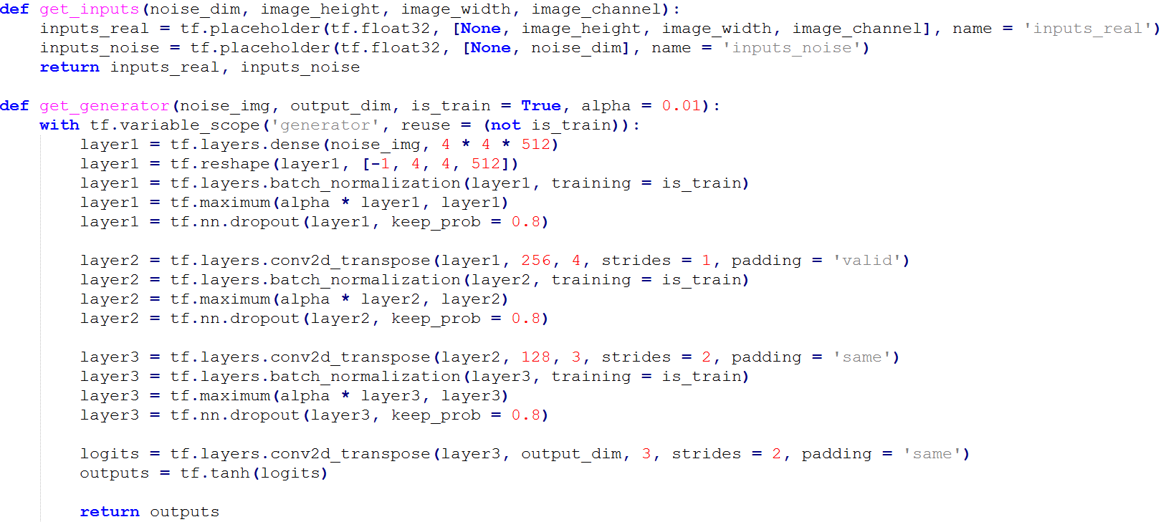
DCGAN on MNIST in tensorflow

Slide 19
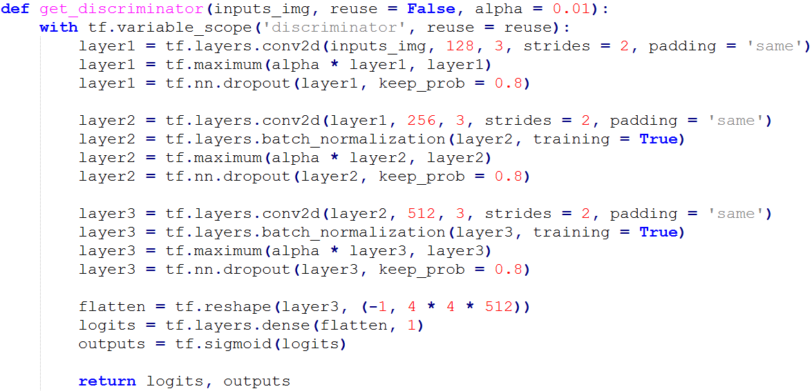
DCGAN on MNIST in tensorflow

Slide 20
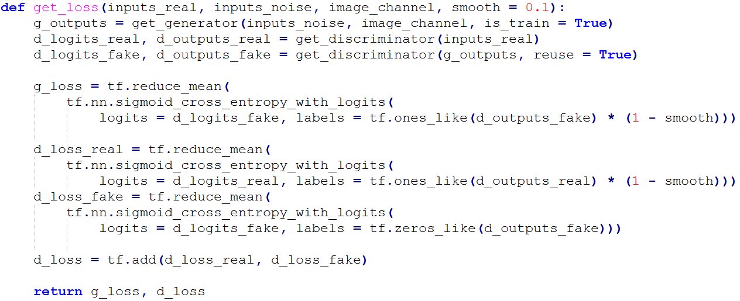
DCGAN on MNIST in tensorflow

Slide 21
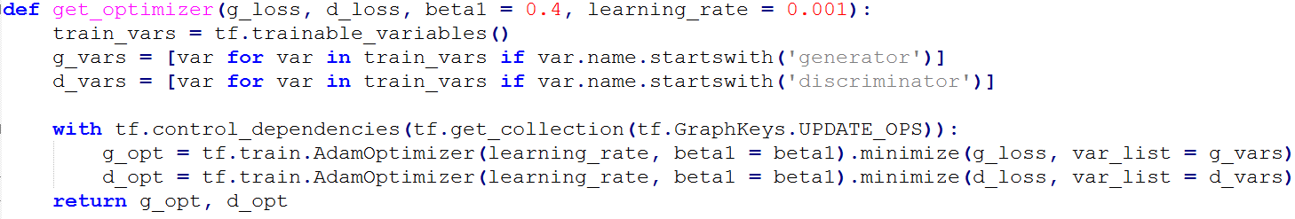
DCGAN on MNIST in tensorflow

Slide 22
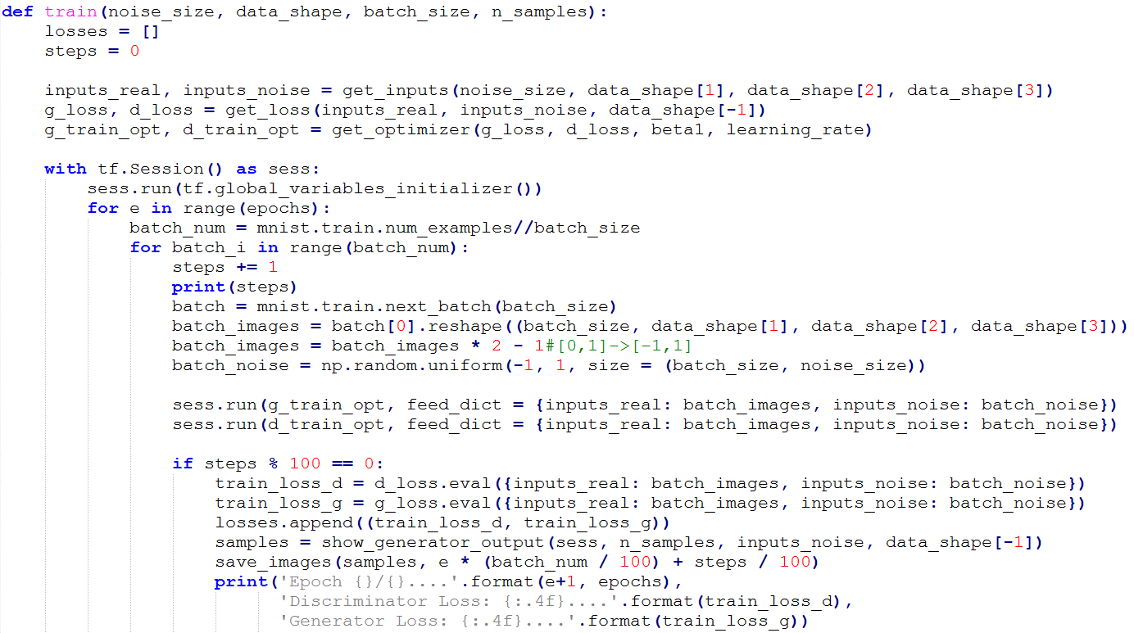
DCGAN on MNIST in tensorflow

Slide 23
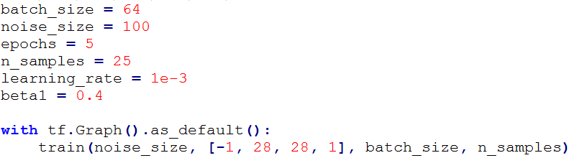
DCGAN on MNIST in tensorflow

Slide 24
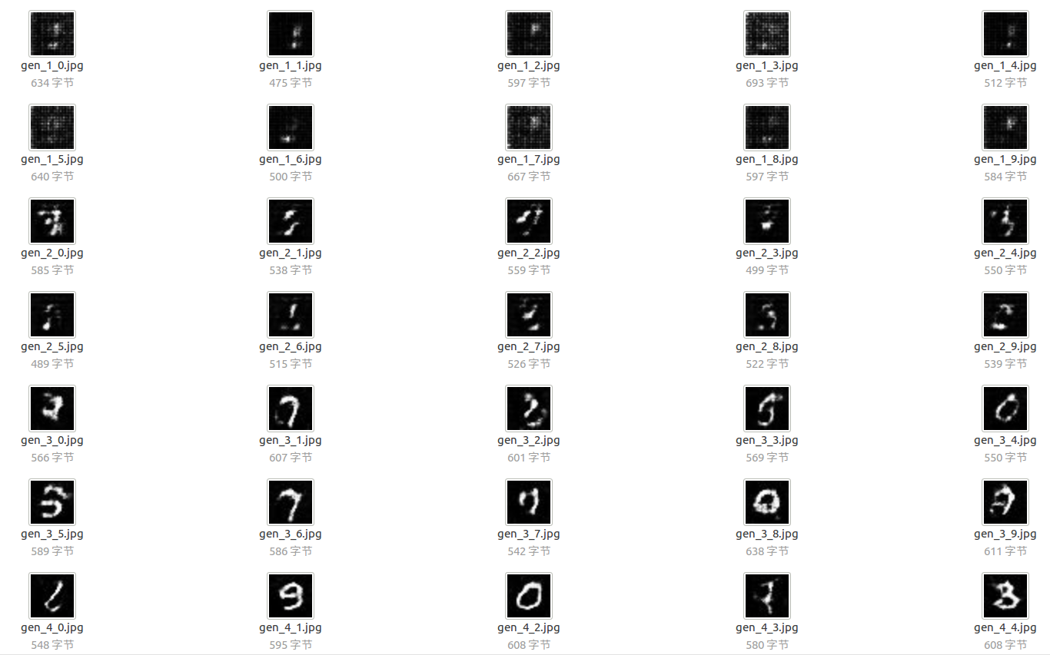
DCGAN on MNIST in tensorflow

Slide 25
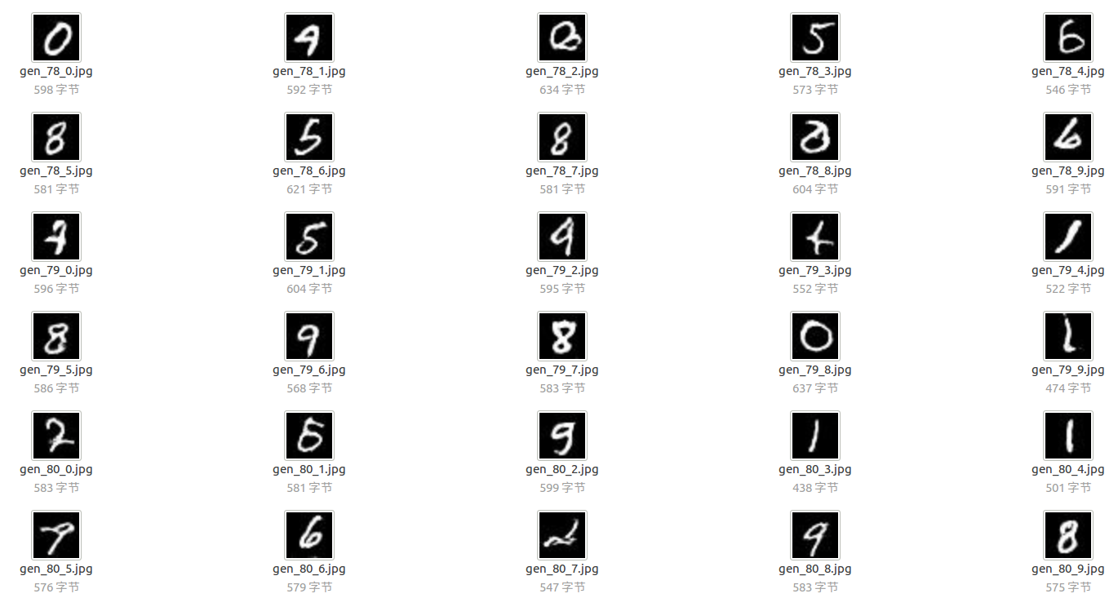
DCGAN on MNIST in tensorflow

Slide 26
Problem: hard to achieve Nash equilibrium
In a GAN, the generator is playing a non-cooperative game with the discriminator.
Nash equilibrium is hard to achieve.
Example:
A want to maximize f(x)=xy while B want to minimize g(y)=xy.
Both using gradient descent.
A: update x with x+λy
B: update y with y- λx

Slide 27
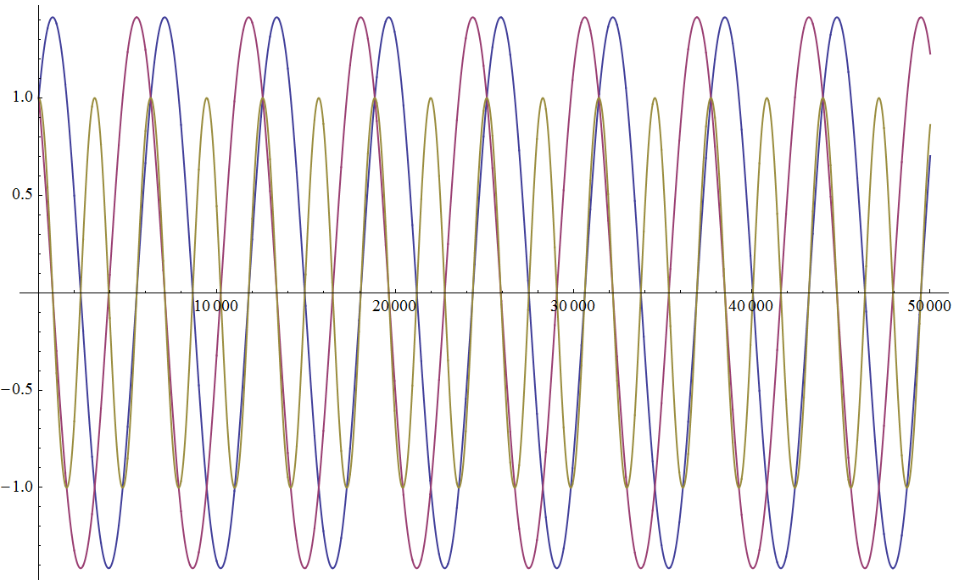
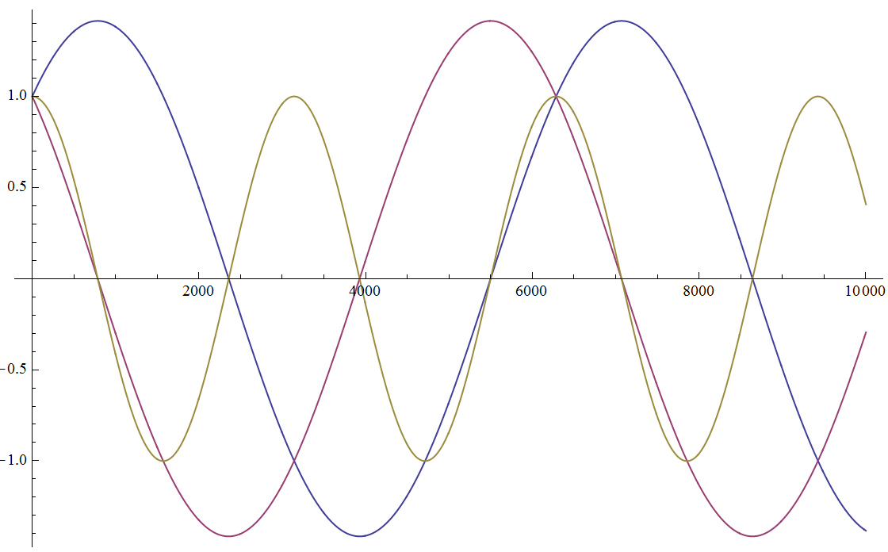
Problem: hard to achieve Nash equilibrium
x0=1 y0=1 learning_rate=1e-3

Slide 28
Problem: hard to achieve Nash equilibrium
For discriminator:
Maximize Ex~pr(x)[logD(x)]+ Ez~pz(z)[log(1-D(G(z)))]
For generator:
Minimize Ez~pz(z)[log(1-D(G(z)))]

Slide 29
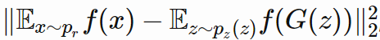
Idea: Feature matching(Intuition)
Instead of directly maximizing the output of the discriminator, the new objective requires the generator to generate data that matches the statistics of the real data.
Letting f (x) denote activations on an intermediate layer of the discriminator, our new objective for the generator is defined as:

Slide 30
Introduction: WGAN
What’s the problem of origin GAN？
Concluded in one word:
The better the discriminator is, the worse the gradient decay of the generator is.

Slide 31
Introduction: WGAN
Mathematical analysis:
With the generator fixed, what’s the best discriminator ?
loss
Derivative
Best discriminator

Slide 32
Introduction: WGAN
generator loss
KL divergence
JS divergence

Slide 33
Introduction: WGAN
What is TRUE: The closer two distributions are, the smaller their JS divergence is.
But, when two distributions barely overlap, what’s their JS divergence?
log2

Slide 34
Introduction: WGAN
When the support sets of Pr and Pg are low-dimensional manifold in a high-dimensional space, the probability is 1 that the measure of their overlap equals 0.
So, the better the discriminator is, the worse the gradient decay of the generator is.

Slide 35
Introduction: WGAN
One way to avoid this is to add noise to generated samples and real samples, which forces these two distributions to overlap.
Can we use a better divergence between these two distributions?

Slide 36
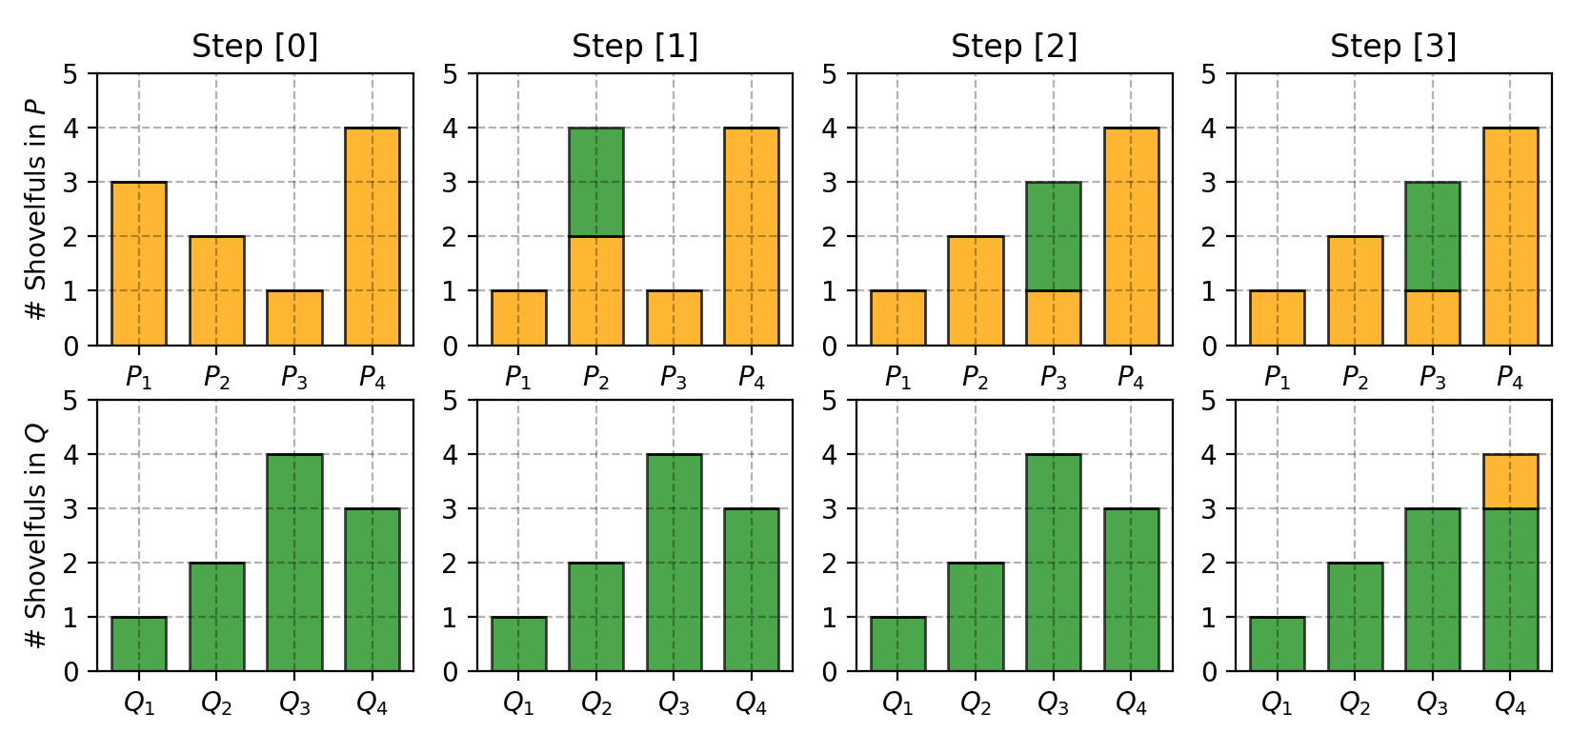
Introduction: WGAN
Two dirt distributions P, Q
P(1)=3, P(2)=2, P(3)=1, P(4)=4
Q(1)=1, Q(2)=2, Q(3)=4, Q(4)=3

Slide 37
Introduction: WGAN
Wasserstein distance:
One joint distribution γ∈Π(pr,pg) describes one dirt transport plan.
Precisely, γ(x, y) states the percentage of dirt that should be transported from point x to y so as to make x follows the same probability distribution of y.

Slide 38
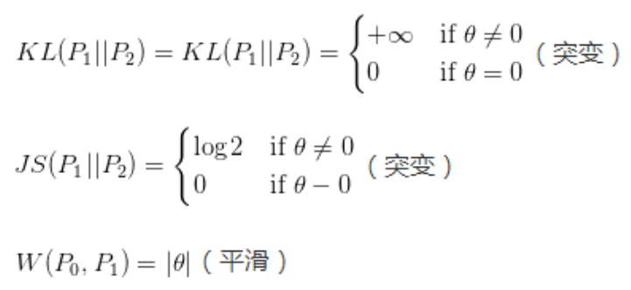
Introduction: WGAN
Consider two distributions P1, P2， P1 takes a uniform distribution on a segment and P2 on another at a distance of θ.

Slide 39
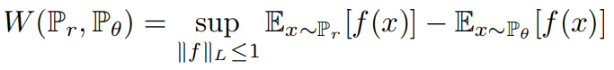
Introduction: WGAN
But this value cannot be calculated.
Can be replaced by:
Lipschitz continuity:

Slide 40
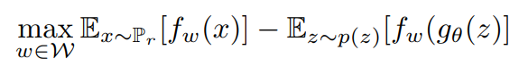
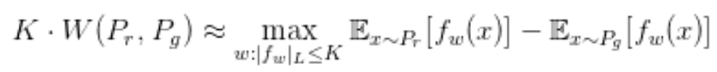
Introduction: WGAN
Approximate
with
We can also replace 1 with K, and divide K later.
Finally it becomes:

Slide 41
Introduction: WGAN
Function with parameter w: Neural network!
Just create a neural network with parameter w, last layer of which isn’t an activation layer, and clip w when going too large.
New loss function:

Slide 42
Introduction: WGAN
Discriminator: learn a K-Lipschitz continuous function to help compute Wasserstein distance.
Generator: learn to output data closer to the real data.

Slide 43
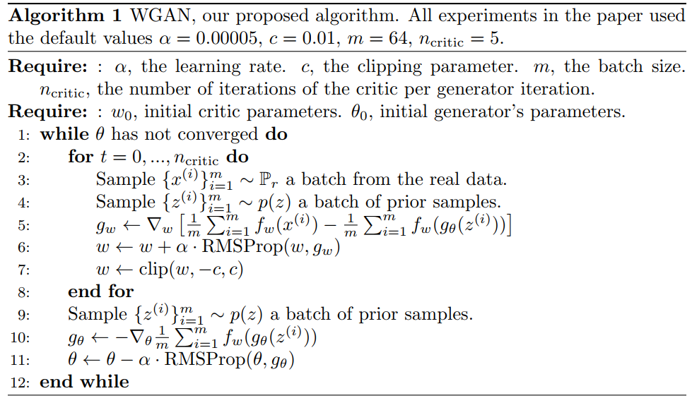
Introduction: WGAN

Slide 44
Introduction: WGAN
Compared with original GAN, only 4 changes:
Remove the last activation layer in the discriminator
Remove log in loss function
Clip the discriminator params to [-c, c]
Don’t use optimizer based on momentum like Momentum and Adam, use RMSProp or simple SGD instead
But a completely different theory!

Slide 45
Application of GAN
Text to image generation
Image to image translation
Increase image resolution

Slide 46
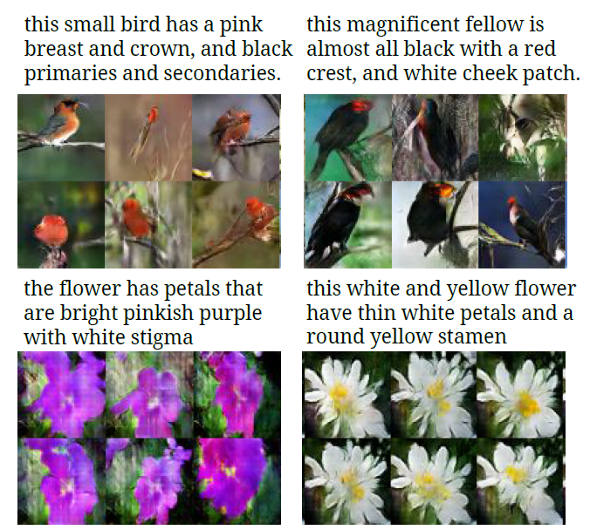
Text to image translation

Slide 47
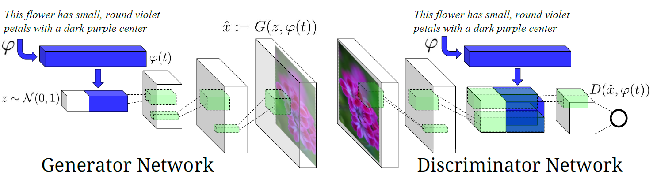
Text to image translation

Slide 48
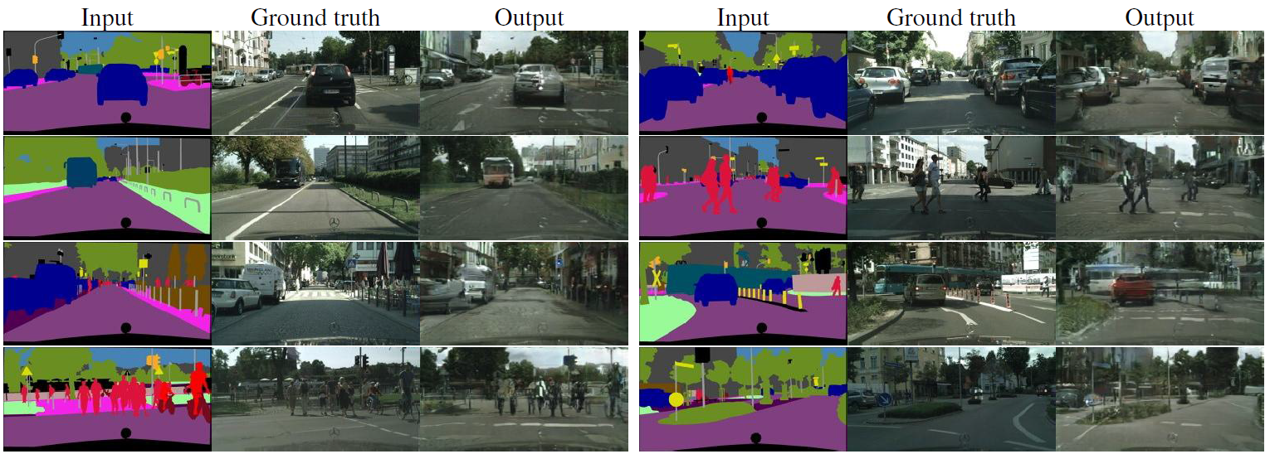
Image to image translation
Labels to Street Scene

Slide 49
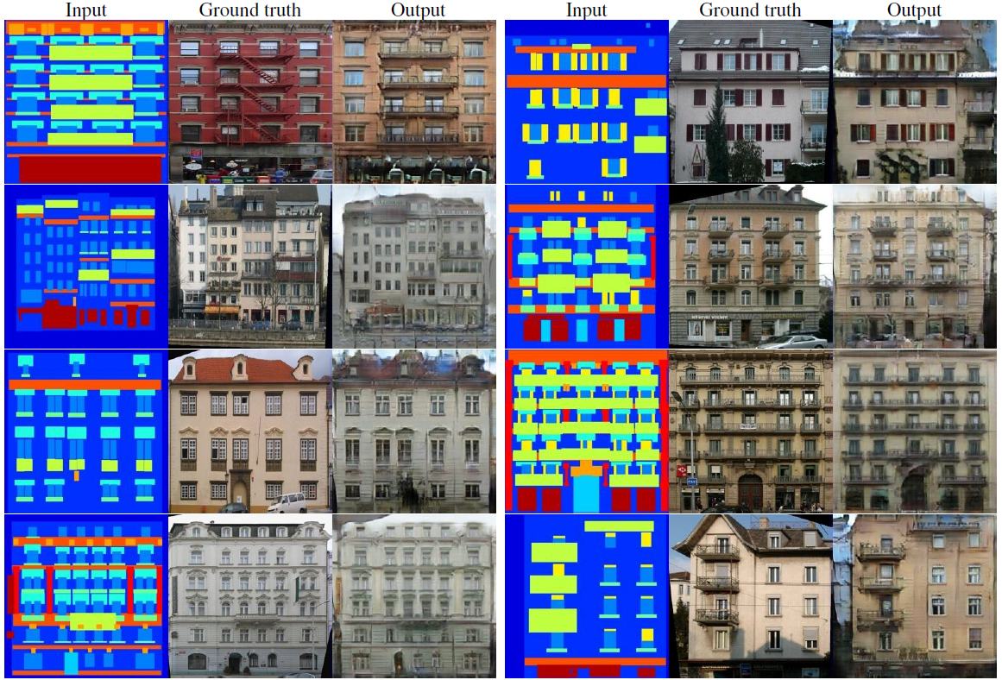
Image to image translation
Labels to Facade

Slide 50
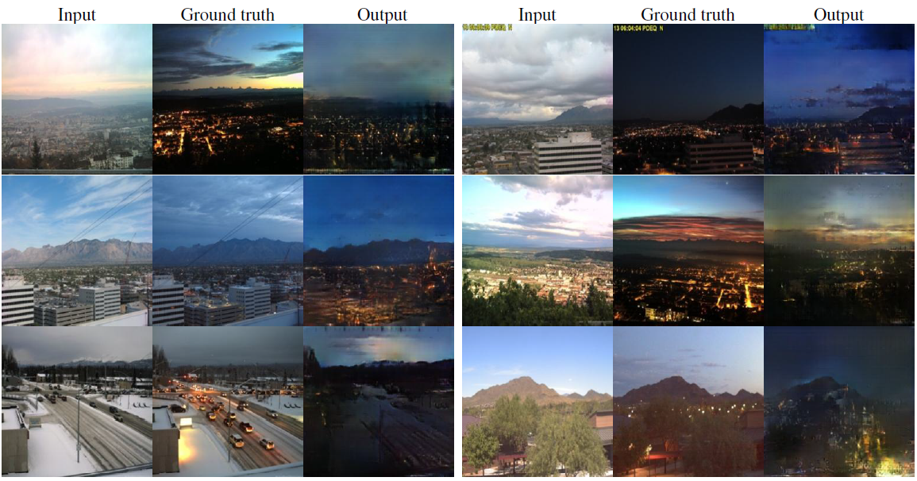
Image to image translation
Day to night

Slide 51
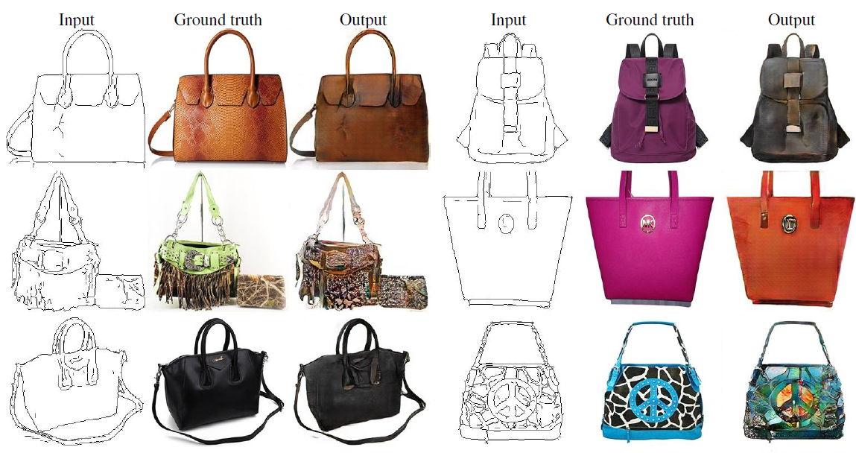
Image to image translation
Edges to handbags

Slide 52
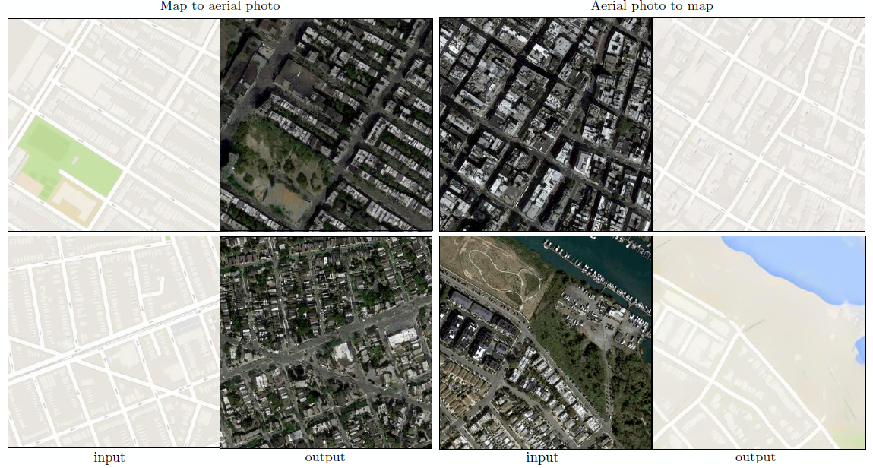
Image to image translation

Slide 53
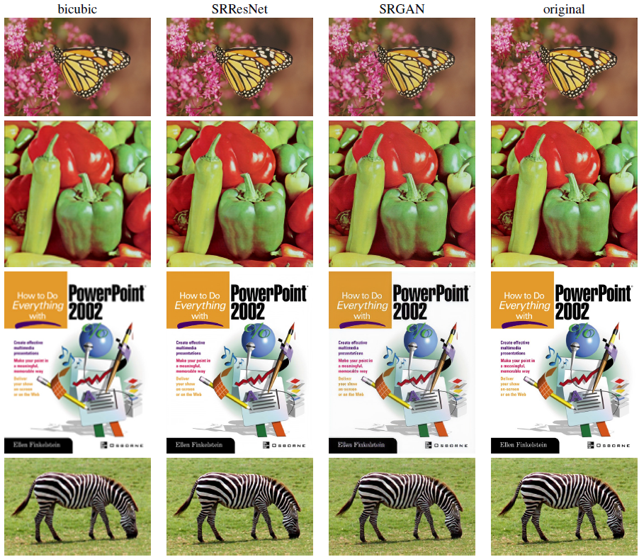
Increasing image resolution

Slide 54
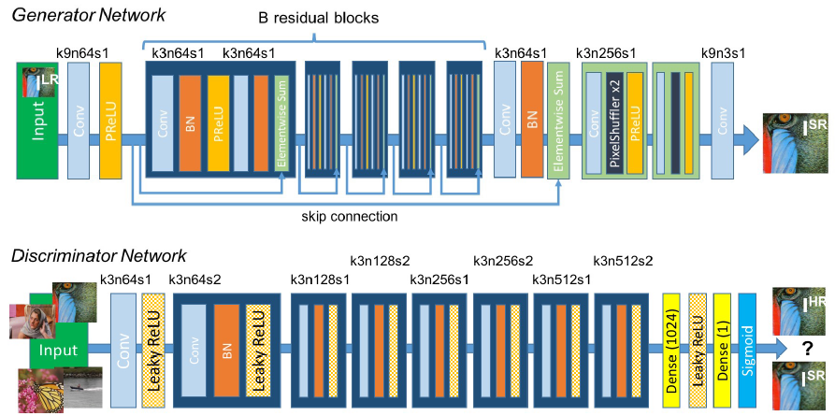
Increasing image resolution

Slide 55
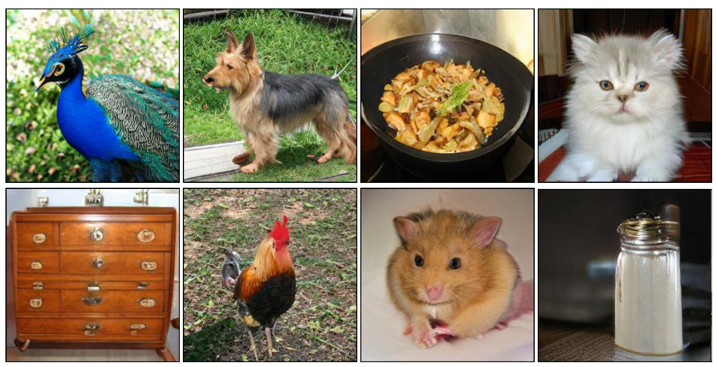
Current state-of-the-art

Slide 56
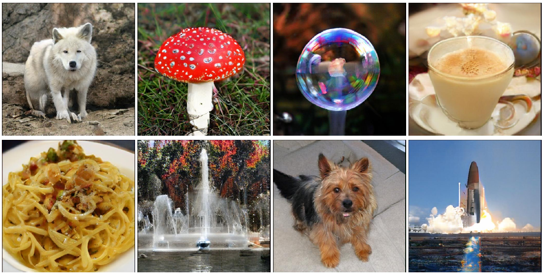
Current state-of-the-art

Slide 57
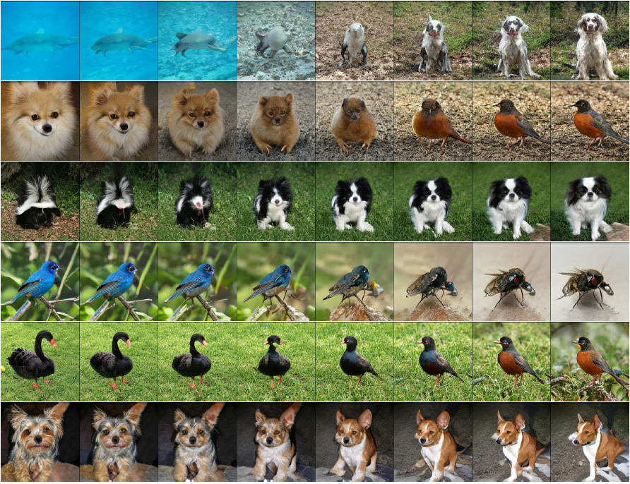
Current state-of-the-art

Slide 58
Reference
“Generative Adversarial Nets” arxiv:1406.2661
“Conditional Generative Adversarial Nets” arxiv:1411.1784
“UNSUPERVISED REPRESENTATION LEARNING WITH DEEP CONVOLUTIONAL GENERATIVE ADVERSARIAL NETWORKS” arxiv:1511.06434
“Improved Techniques for Training GANs” arxiv:1606.03498
“TOWARDS PRINCIPLED METHODS FOR TRAINING GENERATIVE ADVERSARIAL NETWORKS” arxiv:1701.04862
“Wasserstein GAN” arxiv:1701.07875
“Generative Adversarial Text to Image Synthesis” arxiv:1605.05396
“Image-to-Image Translation with Conditional Adversarial Networks” arxiv:1611.07004

Slide 59
Reference
“Photo-Realistic Single Image Super-Resolution Using a Generative Adversarial Network” arxiv:1609.04802
“UNSUPERVISED LEARNING OF VISUAL STRUCTURE USING PREDICTIVE GENERATIVE NETWORKS” arxiv:1511.06380
“LARGE SCALE GAN TRAINING FOR HIGH FIDELITY NATURAL IMAGE SYNTHESIS” arxiv:1809.11096
“A Beginner's Guide to Generative Adversarial Networks”
https://skymind.ai/wiki/generative-adversarial-network-gan
“From GAN to WGAN”
https://lilianweng.github.io/lil-log/2017/08/20/from-GAN-to-WGAN.html

